Slide 1
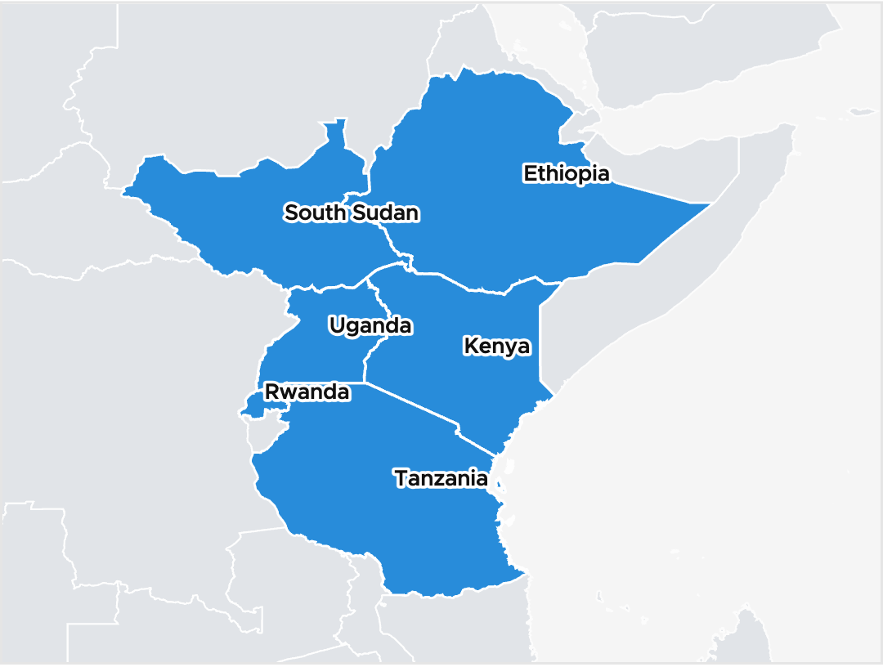
jenga.fund
Backing East Africa's AI builders
jenga KISWAHILI verb
to build.
The Jenga Fellowship supports East African technical talent building online ventures at their own pace.
A focus on Anglophone East African countries
01 / 06

Slide 2
WHY NOW
Local talent, a global market.
East Africa has more capable young builders than it has traditional jobs. AI lets them ship real products, and the internet lets them sell those products anywhere. That combination is new.
TALENT
TOOLS
MARKET
1 in 3
Months → Days
$15B → $300B
of the world's young people will be African by 2050, the youngest workforce on earth.
What took a team months, a motivated builder now ships in days with AI.
Africa's SaaS market versus the global one. Both are wins.
02 / 06

Slide 3
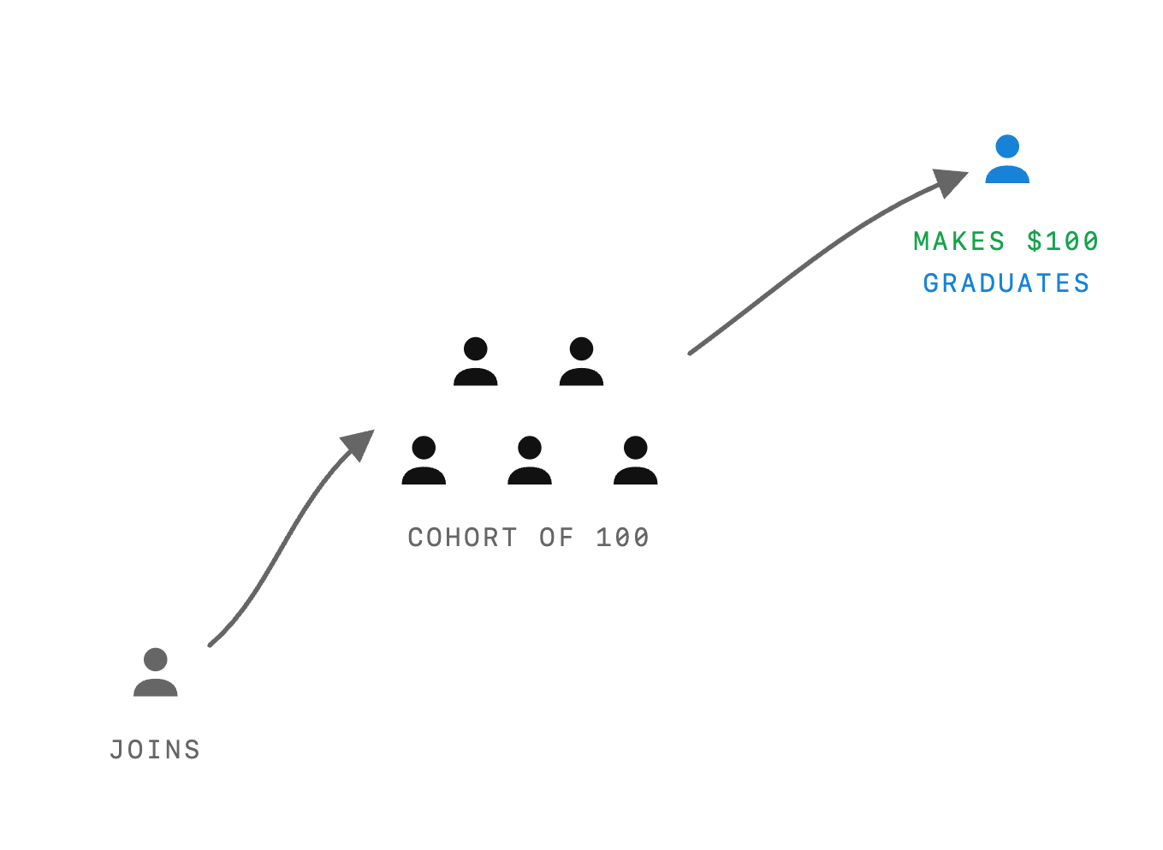
A rolling cohort of 100, climbing to their first $100
Jenga Fellows runs as one self-paced virtual cohort. A new fellow joins only when someone graduates or drops out. They graduate when they earn their first $100 online.
03 / 06

Slide 4



01
TOOL ACCESS
Codex and Claude Code
Not just access. A support system.
Frontier agent seats, removing the $20 to $200 a month access bottleneck.
02
LIVE RHYTHM
Build Hours and Demo Days
Weekly Build Hours to get unstuck, and Demo Days to celebrate shipped work.
Each Jenga Fellow gets frontier tools, a weekly live rhythm to get unstuck and celebrate wins, and an always-on forum that carries momentum between sessions.
03
ALWAYS ON
A builder forum
An always-on forum where alumni and vetted mentors answer questions between the live sessions.
04 / 06

Slide 5
A $60K pilot. A $100K raise.
Fellow
$20 / mo
Vetted in. Entry agent seat.
↓ SHOWS REAL PROMISE
Most fellows never need more than the $20 seat. Only those who ship and earn break through to $200, so spend tracks results.
Promising
$100 / mo
Building something real. More usage to accelerate.
↓ EARNS FIRST $100, STARTS MENTORING
Six months runs one cohort of 100. The raise leaves a buffer for what we learn, and graduates come back as TAs so the next costs less.
TA
$200 / mo
Graduated. Mentors the cohort.
PROVISIONAL FIGURES, REPLACE WITH YOUR MODEL.
05 / 06

Slide 6
WHAT WE'RE RAISING FOR
Run the program, back the businesses.
Operations
Tools, Build Hours, review, and the forum that keep a cohort of 100 running.
Investment
A pool to back fellows' ventures as they grow, like an early-stage fund.
As those businesses grow, a share of the returns recycles into the fund, so Jenga leans less on grants each cohort.
06 / 06

